Slide 1
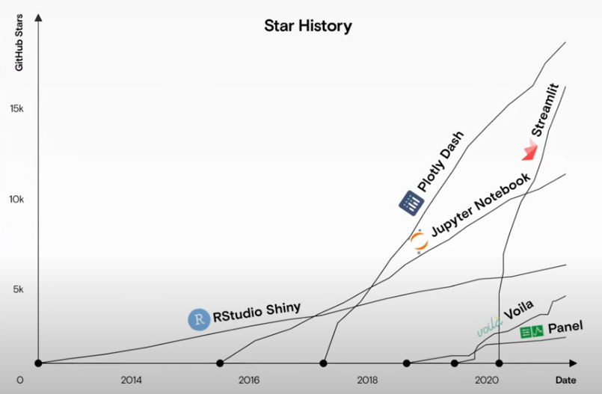
Examples
L.E.A.D.S - TECHNOLOGY DASHBOARD
https://aeromaps.isae-supaero.fr/discovery
https://aeroscope.isae-supaero.fr/
https://webfoil.engin.umich.edu/
https://stratifly.engin.umich.edu/gui
How to build something like this?
Python ← streamlit package
GitHub
GitLab
Computation tools + Dashboard
Deploying on the internet
Python Dashboard packages

Slide 2
What we need to discuss today is what to show. (Process and GUI)
Example process
➔ Please note that the internship students will stay with us for a month, so we will not develop a computation module but will focus on completing a set of the deployed website.
Inputs
Aircraft selection,
Design range, capacity
Energy vector
Outputs
Characteristic masses, fuel, energy, CO2,
Payload – Range diagram,
aircraft 3 view diagram,
COC, DOC
Computation
GAM
Backend database
Aircraft database

Slide 3
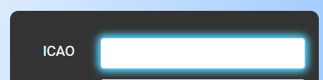

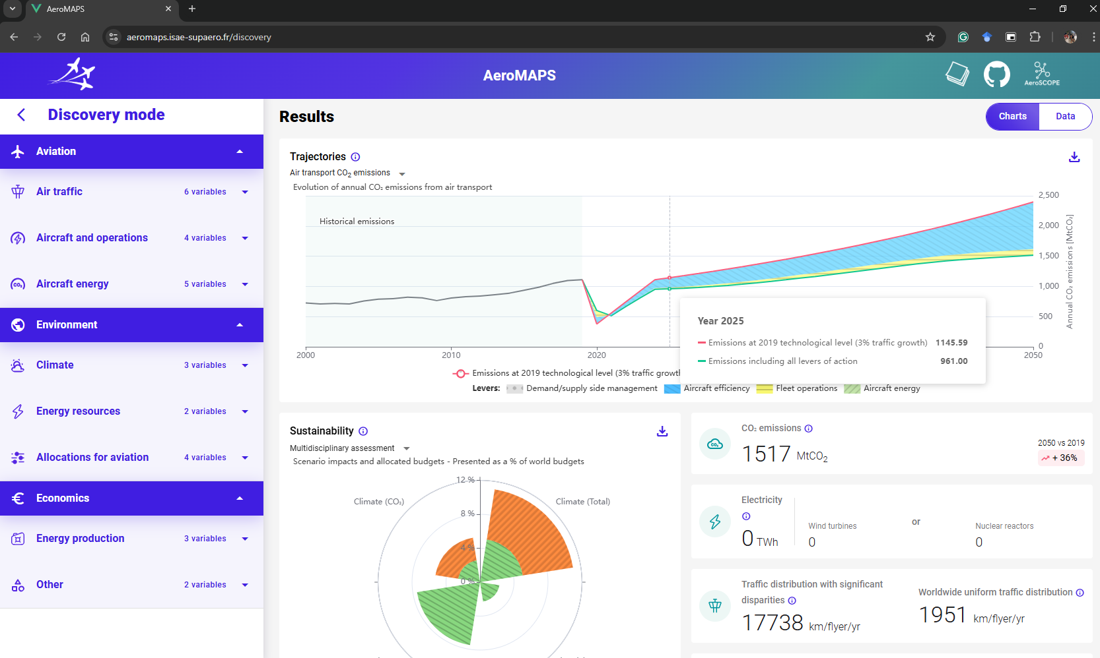

What we need to discuss today is what to show. (Process and Graphic User Interface)
Example GUI
Inputs
Aircraft selection,
Design range, design nPax,
Flight Origin-Destination
Energy vectors
(efuel, hydrogen, methane, battery, etc.)
-compare (memorize to build graphs)
Payload
Outputs
Characteristic masses(accumulated bar chart), fuel, energy, CO2,
Payload – Range diagram,
aircraft 3 view diagram,
COC, DOC, summary of aircraft characteristics
Origin
Destination
Range
3000 NM
Range

Slide 4
Report
Let’s try to submit a journal paper
https://joss.theoj.org/
https://joss.readthedocs.io/en/latest/paper.html

Slide 5
December 3 (meeting minutes)
Tasks
1) Remove geometry information from the data shown on the dashboard.
Keep only: airplene_type, name, iata_code, icao_code, constructor, n_pax, owe, mtow, mlw, n_engine, engine_type, powerplant(TBD), bpr, energy_type, max_power(note: no max_power_2), max_thrust, cruise_speed, cruise_altitude, nominal_range.-----should we consider a shorter list?
2) Transpose the column header (horizontal to vertical)
3) Remove row numbering in the database shown on the dashboard.
4) Change the position of “By Aircraft Constructor” to the utmost.
5) In the table shown on the dashboard, put “aircraft name” and “ICAO code” close to each other.
6) Remove business jet from the category selection (business jet can belong to any type of category)
7) Is it possible to show an interactive table on the dashboard?
8) Add unit selection and show unit change, either imperial unit or metric unit (note: no conversion for the speed, GAM uses SI unit, so there should be one more unit conversion for the input of GAM.)
9) Grouping outputs.
10) Show a graph with the selection of x and y-axis properties.
11) Use factors (e.g. max_payload_factor, max_fuel_factor) as tweaking parameters.
12) Add text input in addition to the slide bar

Slide 6
Concept
Basic GAM
Inputs
A/C parameters
Mission parameters
Internal parameters
Output
Tuning design parameters to generate a reference aircraft
Inputs
Aircraft selection
Outputs
A/C Airplane Database
design_airplane
tune_design
Tweak design
Inputs
Updating A/C parameters
Updating Mission parameters
Updating Internal parameters
design_airplane
Superimpose outputs
Outputs

